Slide 1
14/3 – 17/4
POLO POLO (3G)

Slide 2
FAMILY SET (3G)

Slide 3
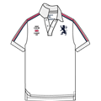
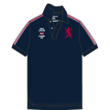
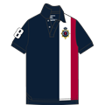

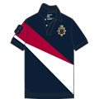
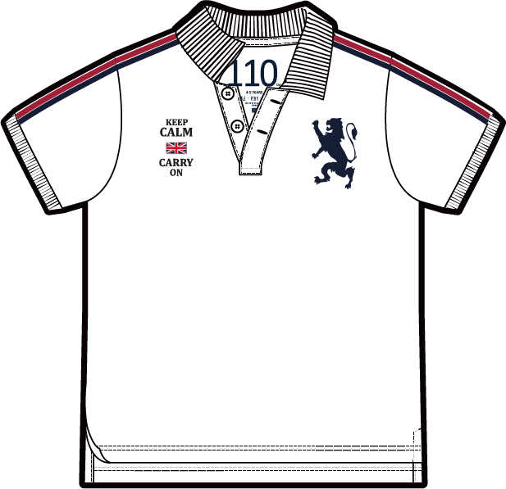
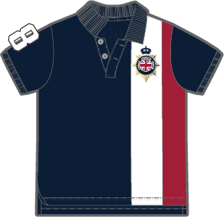
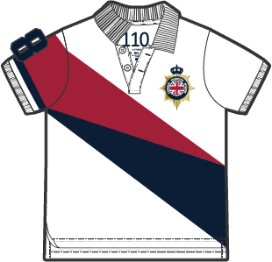
MALAYSIA
Functional Store
Domain: Sports Polo
Season:2019 SS
Module:SS19 Module 1
14th March – 17th April19
MEN
WOMEN
Style Code:01018322 ...
Description:CTN/LYCRA PQE FLT KNT CLR SS TPR EMBRDRY PLO (BLD UNN JCK)
Content: 97% Cotton 3% Lycra
Colors: 28 29 44 46 47
Retail: RM119/pc
Target: 1520pcs/wk
Qty : 6500pcs PO : 18MY000894 ETA : 13/3
JUNIOR
Style Code:03018322
Description: CTN/LYCRA PQE FLT KNT CLR SS SLM
EMBRDRY PLO(BLD 3D LN)
Content:97% cotton 3% lycra
Colors: 28, 35, 37
RP: RM119
Target: 200pcs/week
Qty : 1000 PO : 18MY000923/963ETA : TBA

Slide 4
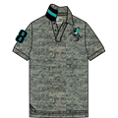
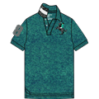
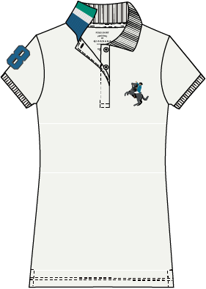
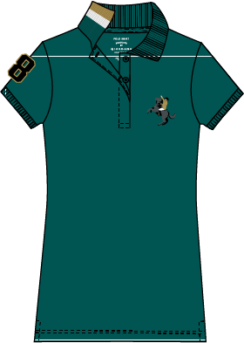
MALAYSIA
Functional Store
Domain: Napoleon & Classic Men Polo
Season:2019 SS
Module:SS19 Module 1
14th March – 17th April19
MEN
WOMEN
JUNIOR
Style Code:01019210 ...
Style Code:05319210 ...
Description:CTN/LYCRA PQE FLT KNT CLR SS TPR EMBRDRY PLO (BLD NPLN)
Description:W CTN/LYCRA PQE FLT KNT CLR
SS CLSC SLM EMBRDRY PLO (NPLN)
Colors: 40[Melange Mid Grey(AB) [Grey]] 45[Melange Quetzal Green(Double Dyed)[Green]]
Content:97% cotton 3% lycra
Content:97% cotton 3% lycra
Colors: 02, 04
Retail: RM119/pc
RP: RM119
Target: 500pcs/week
Target: 560pcs/wk
Qty : 1200 PO : 18MY000965 ETA : TBA
Qty : 2400pcs PO : 18MY000893 ETA : 13/3

Slide 5
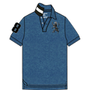
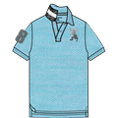
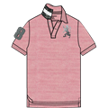
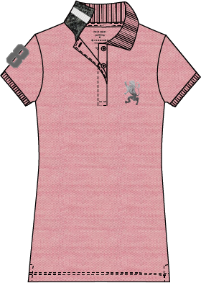
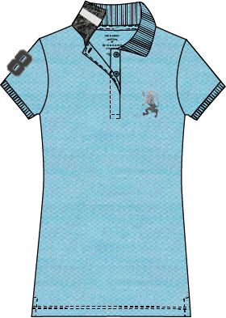
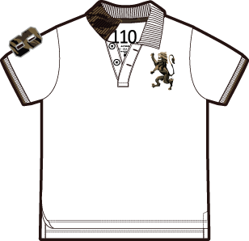
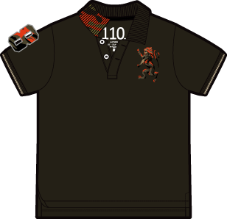
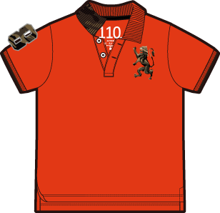
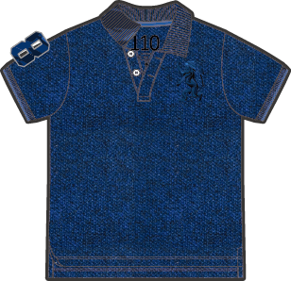
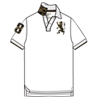
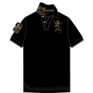
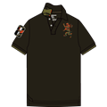
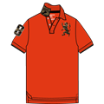
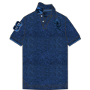
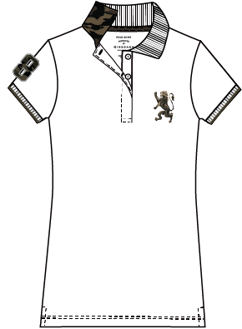
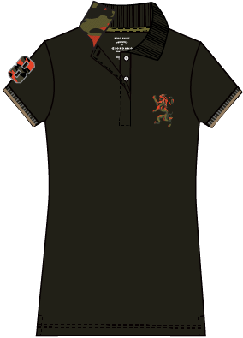
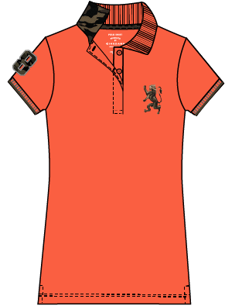
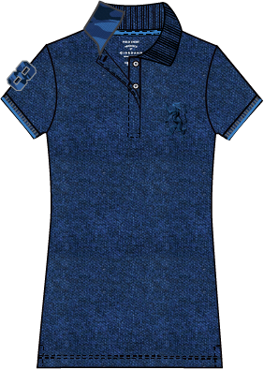
MALAYSIA
Functional Store
Domain: 3D Lion Polo
Season:2019 SS
Module:SS19 Module 1
14th March – 17th April19
MEN
WOMEN
JUNIOR
Style Code:01018222 ...
Style Code:05319202 ...
Description:CTN/LYCRA PQE FLT KNT CLR SS TPR EMBRDRY PLO (BLD 3D LN)
Description:W CTN/LYCRA PQE FLT KNT CLR SS CLSC SLM
EMBRDRY PLO
Style Code:03018401
Content:97% cotton 3% lycra
Content:97% cotton 3% lycra
Description: CTN/LYCRA PQE FLT KNT CLR SS SLM
EMBRDRY PLO( MLTRY BLD LN)
Colors: 42 43 45
Colors: 58, 59
Content:97% cotton 3% lycra
Retail: RM119/pc
RP: RM119
Target: 500pcs/week
Colors: 11, 14, 16, 87
Target: 1000pcs/wk
RP: RM119
Target: 200pcs/week
Qty : 3900pcs PO : 18MY000891 ETA : 13/3
Qty : 1200PO : 18MY000884 ETA : TBA
Qty : 2200 PO : 18MY000538 ETA : TBA
Style Code:01018401
Description:CTN/LYCRA PQE FLT KNT CLR SS SLM EMBRDRY PLO (MLTRY 1 - BLD LN)
Content:97% cotton 3% lycra
Colors: 11[Signature White[White]] 12[Signature Black[Black]] 14[Rosin[Green]] 16[Koi[Orange]] 17[Melange Dark Baleine Blue[Blue]]
Retail: RM119.00
Target: 1450pcs/wk
Qty : 6100pcs PO : 18MY000473 ETA : 13/3
Style Code:05318401 ...
Description:W CTN/LYCRA PQE FLT KNT CLR SS CLSC SLM
EMBRDRY PLO (MLTRY 1 – BLD LN)
Content:97% cotton 3% lycra
Colors: 11, 12, 14, 15
RP: RM119
Target: 500pcs/week
Qty : 3300PO : 18MY000470 ETA : TBA

Slide 6
GIORDANO MEN

Slide 7
MARCH19
POLO POLO
GM PRODUCT FOCUS
CAT 01 – Polo (3G)

Slide 8
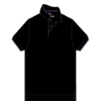
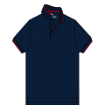
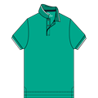
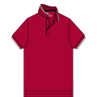
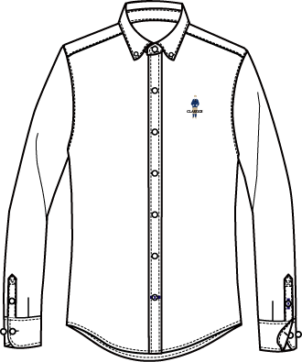
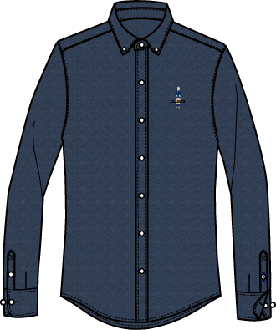
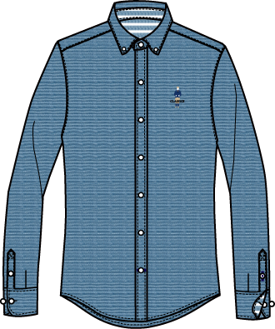
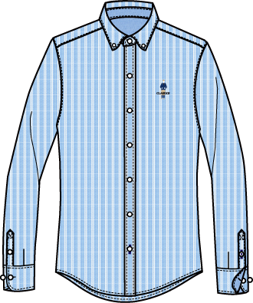
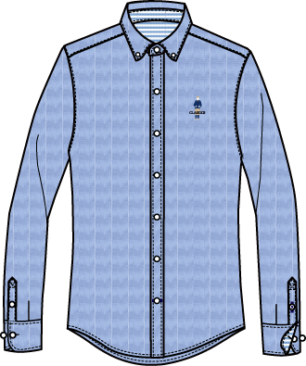
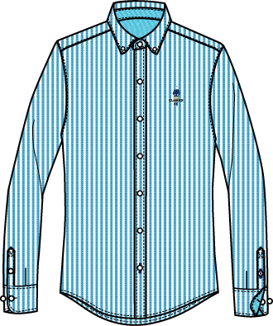
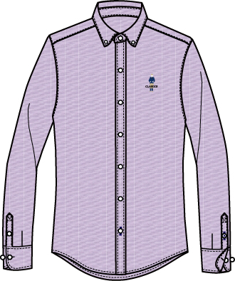
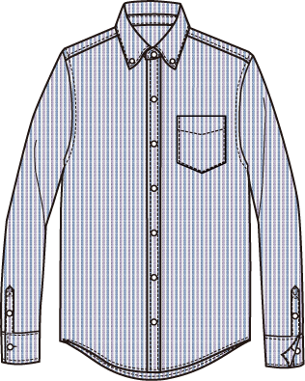
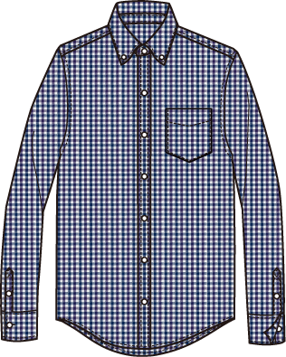
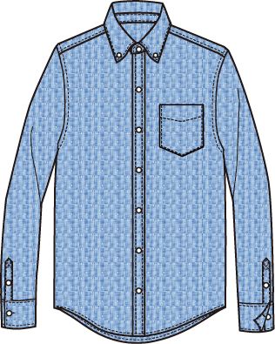
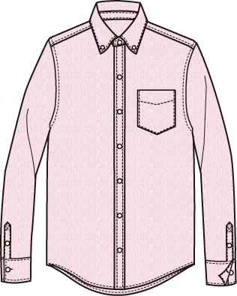
MALAYSIA
Functional Store
Domain: CVC Polo
Season:2019 SS
Module:SS19 Module 1
14th March – 17th April19
Style Code:01019018 ...
Description:CTN/PLYSTR PQE FLT KNT CLR SS TPR PLO (SLD CVC)
Content:60% Cotton 40% Polyester
Colors: 02[Signature Black [Black]] 03[Signature Navy [Blue]] 05[Peacock Green [Green]] 07[Haute Red [Red]]
Retail: RM98/pc
Target:2300pcs/wk
Qty : 6500pcs PO : 18MY000885 ETA : 13/3
MALAYSIA
Functional Store
Domain: M’s Shirts
Season:2019 SS
Module:SS19 Module 1
14th March – 17th April19
Style Code:01049043
Style Code:01049009
Description: CTN/LYCRA OXFRD FL OPNNG LS
SLM EMBRDRY GRMNT WSH SHRT CLSC MN
Description: CTN OXFRD FL OPNNG LS RGLR BTN FRNT
WRNKLE FRE SHRT (Wrinkle Free)
Content:96% Cotton & 4% Lycra
Content:100% Cotton
Colors: 01[White] 04[Navy] 05[Dusk Blue] 10[Blue x White] 11[Blue] 14[Turquoise x White] 18[Purple]
Colors: 03[White x Blue/Purple] 04[White x Navy/Purple] 11[Light Blue Dobby] 14[Pink Dobby]
Retail: RM159
Retail: RM179
Remark: Selected Shops
Target : 1000pcs/week
Remark: Selected Shops
Target : 60pcs/week
Qty: 8500 PO: 18MY000841 ETA : 12/03 & 29/03/19
Qty: 320 PO: 18MY000997 ETA : 14/03 & 04/04/19

Slide 9
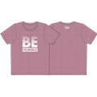



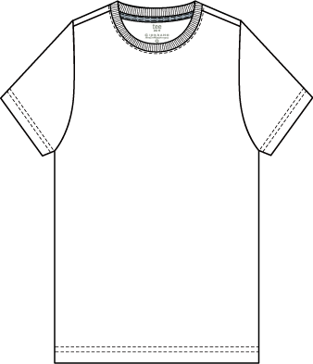
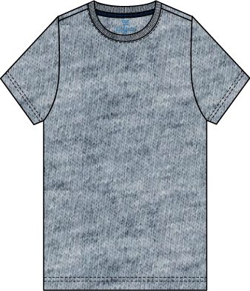
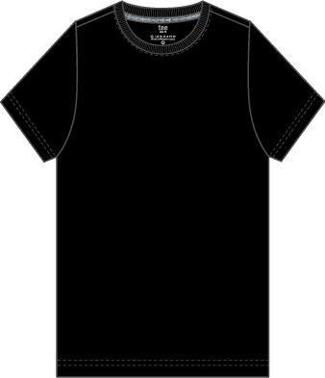
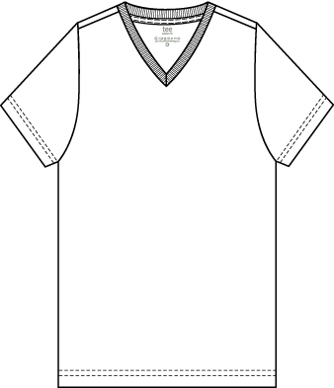
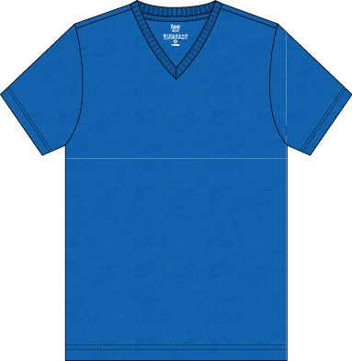












MALAYSIA
Functional Store
Domain: M’s Tees
Season:2019 SS
Module:SS19 Module 1
14th March – 17th April19
MESSAGE TEE (3 for Rm90)
CORE TEE (3 for Rm90)
Style Code:01099226
Description:CTN JRSY CRW NCK SS SLM PRNT PRNT TE (MSGE - BE)
Style Code:01028251
Content:100% Cotton
Style Code:01028219
Description: CTN JRSY V NCK SS MDRN TE (NW MDRN)
Colors: 04[Melange Wild Rose [Pink]] 05[Signature Navy [Blue]] 09[Signature Black [Black]] 11[Melange Medium Indigo Blue [Blue]]
Description: CTN JESY CRW NCK SS SLM TE
Content:100% cotton
Retail:RM49/pc
Content:100% Cotton
Colors:01[Signature White] 05[Melange Indigo Blue]
07[Melange Victoria Blue] 09[Signature Black]
Target: 950pcs/wk
Colors: 01[Signature White] 02[Mid Heather Grey] 03[Signature Black]
04[Signature Navy] 14[Siro Green]
Qty: 4000 PO: 18MY001154 ETA : 13/3
Retail: RM49 (3 for RM90)
Retail: RM49 [3 for RM90]
Remark: All Shops
Target : 2200pcs/week
Remark: All Shops
Target : 500pcs/week
Qty: 9000 PO: 18MY000603 ETA : 06/03, 21/03 & 38/03
Qty: 2700 PO: 18MY000597 ETA : 07/03 & 15/03/19
Style Code:01099208
Description:CTN JRSY CRW NCK SS SLM PRNT PRNT TE (LGO)
Content:100% Cotton
Colors: 04[Signature White] 09[MHG] 10[Signature Black]
Retail: RM49/pc
Target: 700pcs/wk
Qty: 3000 PO: 18MY000970 ETA : 13/3
Season:2018 FW
Module:FW18 Module 5
4th Jan – 10th Feb19
Style Code:01099225
Description:CTN JRSY CRW NCK SS SLM PRNT PRNT TE (MSGE - CLR ME)
Content:100% Cotton
Colors: 01[Signature White [White]] 02[Signature Navy [Blue]] 07[Signature Black [Black]] 12[Ribbon Red [Red]] 27[Signature Black [Black]]
Retail: RM49/pc
Target: 1380pcs/wk
Qty: 5900pcs PO: 18MY001155 ETA : 29/3

Slide 10












MALAYSIA
Functional Store
Domain: M’s Bottom
Season:2019 SS
Module:SS19 Module 1
14th March – 17th April19
SHORTS
Style Code:01109202
Style Code:01107417
Style Code:01109805
Description:CTN/SPNDX TWL LW RSE SLM TPR BRMDA
Description: CTN FRNCH TRY MD RSE CMFRT DRWSTRNG SHRTS
Description: CTN/PLYSTR INTRLCK RGLR PCKT SHRTS
Content:100% Cotton
Content:80% Cotton 20% Polyester
Content:98% Cotton 2% Spandex
Colors: 03[Signature Black] 98[Melange Black]
Colors: 41[Melange Sharkskin] 70[Signature Black]
Colors: 01[Signature White] 09[Signature Black] 14[Crockery] 50[Grape Leaf] 88[Chambray Navy]
Retail: RM79 (Best Buy @ RM39/pc)
Retail: RM79 (Best Buy @ RM39/pc)
Retail: RM129
Target: 1000pcs/week
Remark: All Shops
Target : 850pcs/week
Remark: All Shops
Target : 850pcs/week
Qty : 4800pcs PO : 18MY000863 ETA : 08/03 & 15/03/19
Qty:3000 PO: 18MY000578/579 ETA : 08/03 & 21/03/19
Qty:2400 PO: 18MY000975/973 ETA : 08/03 & 21/03/19
KHAKIS + JEANS
Style Code:01119008 (Skinny Taper)
Description:CTN/SPNDX TWL LW RSE SKNY TPR PNTS
Content:98% cotton 2% spandex
Colors: 09[Signature Black] 15[Silver Lining] 68[Chambray Navy]
C/Forward 11-8026 Skinny Taper Jeans
Retail: RM149
Target: 500pcs/week
C/Forward 11-8039 Skinny Taper Stretch Pants
Qty : 2500pcs PO : 18MY000857/858 ETA : 07/03 & 28/03/19

Slide 11












MALAYSIA
Functional Store
Domain: ACC
Module:SS19 Module 1
Season:2019 SS
Module:FW17 Module 4
6th Dec17 – 6th Jan18
14th March – 17th April19
Style Code:01177014
Style Code:01179139
Style Code:01148001 (GWF Backpack)
Description:CTN RB CLSC 6 PCK BRFS
(JSQRD WSTBND ESSNTLS)
Description:CTN PPLN RGLR 3 PCK BXR (ESSNTLS)
Description:PLYSTR BCKPCK
Content:100% Cotton
Content:100% Cotton
Content:100% Polyester
Colors: 43[White/MHG/Black] 49[Red/MHG/Black]
Colors: 63
Colors: 01 Grey
Retail Px: RM69/pcs (2 for RM120)
Retail Px: RM69/Pack
Retail Px: RM149/Pc
Target: 350pcs/week
Target: 350pcs/week
Target: 200pcs/week
Qty : 805packs PO : 18MY000848 ETA : 07/03/19
Qty : 600packs PO : 18MY000845 ETA : 07/03/19
Qty : 400pcs PO : 18MY000672 ETA : 07/03/19
Style Code:01158002
Style Code:01157022
Description:CTN/NYLN/SPNDX JRSY 2 PCK
INVSBL SCKS (ESSNTLS)
Description:CTN/PLYSTR/ELSTNE 2 PCK PTTRN
PD SCKS (ESSNTLS)
Content:78% Cotton 21% Polyester 1% Spandex
Content:75% Cotton 22% Polyester 3% Spandex
Colors: 49， 50， 78， 80 & 89
Colors: 01, 02, 04 & 06
Retail Px: RM30/pairs (2 for RM45)
Retail Px: RM30/pairs (2 for RM45)
Target: 250pairs/week
Target: 450pairs/week
Qty : 1500pcs PO : 18MY001035 ETA : 18/01/19
Qty :3000pcs PO : 17MY001034 ETA : 29/11/18

Slide 12
GIORDANO WOMEN

Slide 13
MARCH19
POLO POLO
GW PRODUCT FOCUS
CAT 31 – Polo (3G)

Slide 14












MALAYSIA
Functional Store
Domain: W’s Shirts & Dress
Season:2019 SS
Module:SS19 Module 1
14th March – 17th April19
COTTON LYCRA OXFORD GROUP
COTTON POPLIN GROUP
Style Code:05349048
Style Code:05348041
Description:W CTN/LYCRA OCFRD FL OPNNG LS SLM BTN FRNT GRMNT WSH SHRT
Description:W CTN PPLN FL OPNNG LS CMFRT BTN FRNT GRMNT WSH SHRT
Content: 98% Cotton 2% Lycra
Content:100%Cotton
Colors: 01 03 04 75
Colors: 16 25 66
Price: RM149
Price: RM149
Remark:
Remark:
Qty : 4000 PO : 18MY000904/18MY001002 ETA : TBA
Qty : 2400 PO : 18MY000450 ETA : TBA
Style Code:05348043
Description:W CTN PPLN WVN CLR LS CMFRT HLF PLCKT GRMNT WSH SHRT
Content:100%Cotton
Colors: 16 25 68
Price: RM169
Remark:
Qty : 2300 PO : 18MY000419 ETA : TBA
Style Code:05468040
Description:W CTN PPLN FL OPNNG LS LSE DRWSTRNG GRMNT WSH DRS
Content:100%Cotton
Colors: 25 99
Price: RM189
Remark:
Qty : 1400 PO : 18MY000454 ETA : TBA

Slide 15






MALAYSIA
Functional Store
Domain: W’s Top
Season:2019 SS
Module:SS19 Module 1
14th March – 17th April19
MESSAGE TEE & CORE TEE (3 for Rm90)
Style Code:05399202
Description:W CTN JRSY CRW NCK SS CMFRT PRNT TE (MSGE)
Content: 100% Cotton
Colors: 30 34 38 40 44 46
Price: RM49 ( 3 for RM90)
Remark:
Qty : 4800 PO : 18MY001049 ETA : TBA

Slide 16




MALAYSIA
Functional Store
Domain: W’s Bottom
Season:2019 SS
Module:SS19 Module 1
14th March – 17th April19
SHORTS
KHAKIS + JEANS + JOGGERS
Style Code:05419038..
Style Code:05418001 ...
Description: W CTN/PLYSTR/SPNDX DNM MD RSE
SLM TPR PCKT JNS ( BJ)
Description:W CTN/PLSTR/ELSTNE TWL MD RSE SLM
TRP PCKT PNTS (INSM 30 BK)
Content: 49% Cotton 25% Polyester 24% Viscose
Content:81% Cotton 17% Polyester 2% Elastane
Colors: 12, 51
Colors: 05, 87
RP: RM129
Target: 400pcs/week
RP: RM129
Target: 400pcs/week
Qty : 1600 PO : 18MY000935 ETA : TBA
Qty : 1600 PO : 18MY000932 ETA : TBA

Slide 17
GIORDANO JUNIOR

Slide 18
MARCH19
POLO POLO
GJ PRODUCT FOCUS
CAT 01 – Polo (3G)

Slide 19




MALAYSIA
Functional Store
Domain: Boys & Girls
Season:2019 SS
Module:SS19 Module 1
14th March – 17th April19
Style Code:03049073
Description:CTN/SPNDX OXFRD FL OPNNG LS RGLR
EMBRDRY SHRT (CLSC BTN)
Content:96%Cotton 4%Lycra
Colors: 01, 10, 14, 17
RP: RM129
Target: 500pcs/week
BOYS
Qty : 900 PO : 18MY000813 ETA : TBA
GIRLS

Slide 20
Product Overview – Campaign (POLO POLO)
Target Qty sold/Sales$ & GP$
 | TARGET (as per 80% sales thru) | BRAND
QTY SOLD |  | GM – GW – GJ –
SALES (RM) |  | GM – GW – GJ – (AVG ASP - )
GP (RM) |  | GM – GW – GJ – (AVG GP% - )

